Slide 1

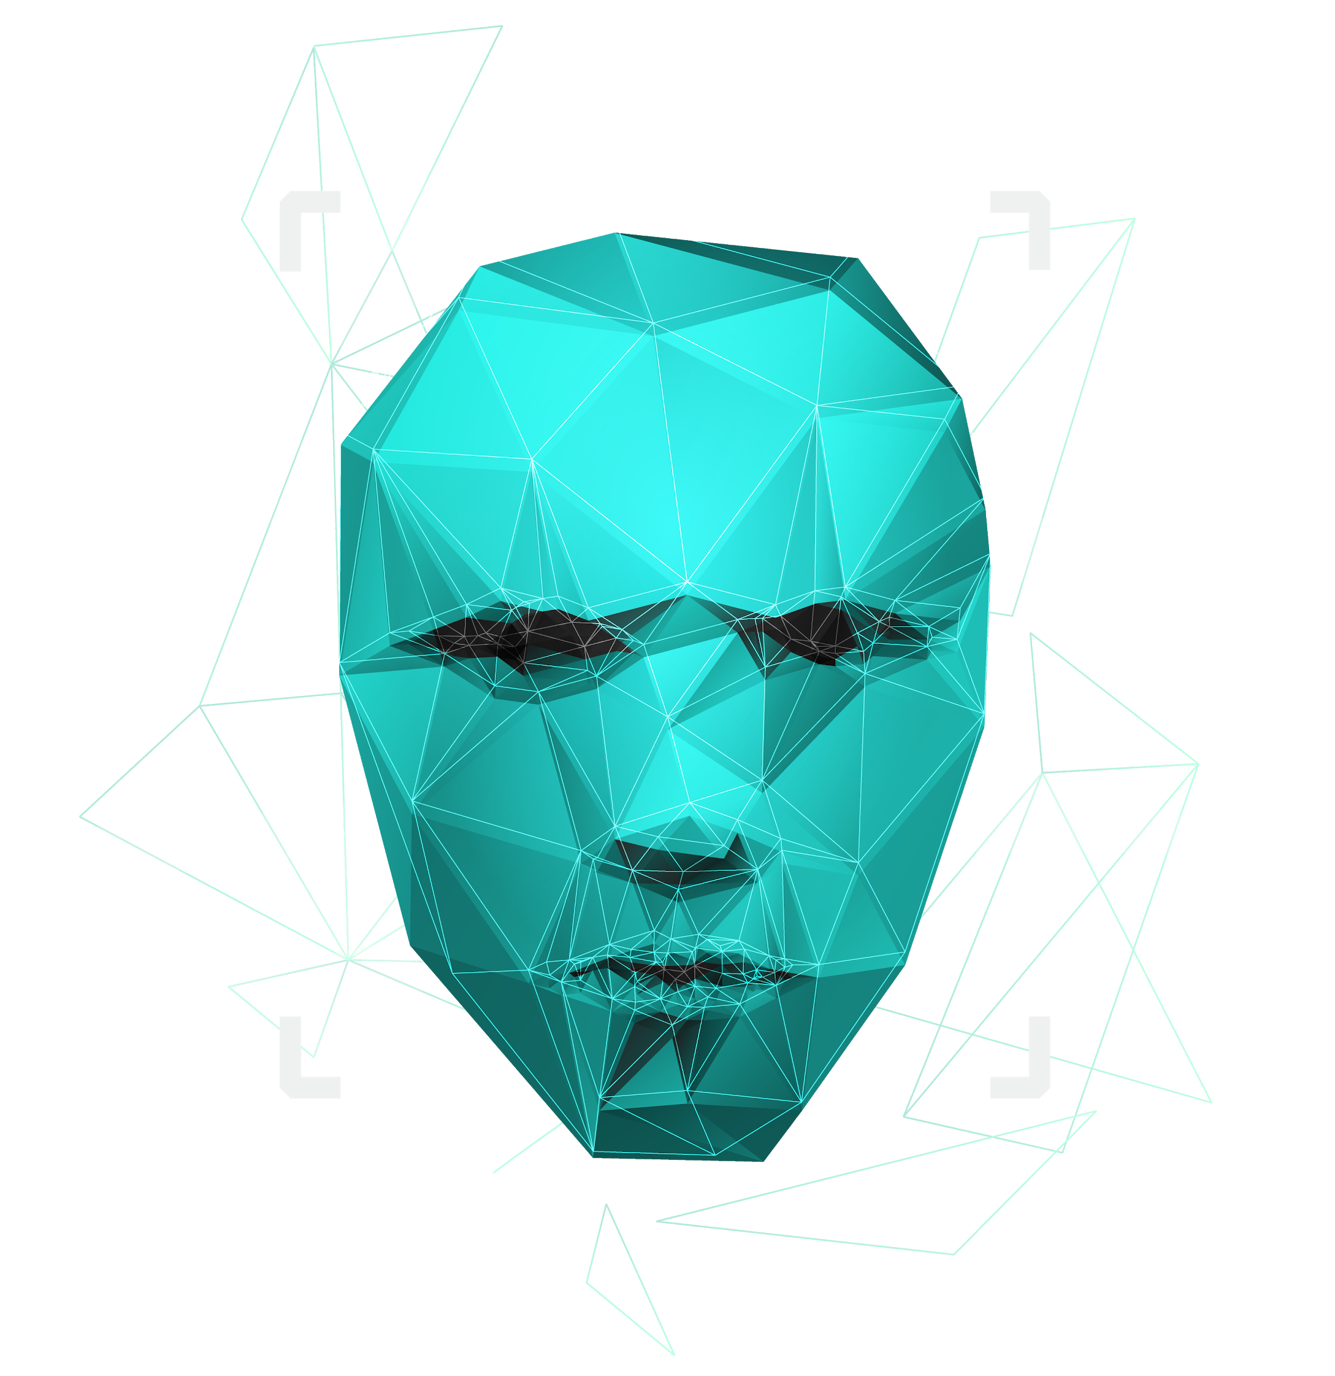
Interactive API based on Guise.
Domain : Computer Vision , API , Web Development , NLP .
M.Nisha [ 211417104167 ]
M.Priyadharshini [ 211417104203 ]

Slide 2

ABSTRACT
Human emotion recognition plays an important role in the interpersonal relationship. The automatic recognition of emotions has been an active research topic from early eras. Therefore, there are several advances made in this field.
Emotions are reflected from speech, hand and gestures of the body and through facial expressions. Hence extracting and understanding of emotion has a high importance of the interaction between human and machine communication . In this project we develop an emotion detecting model using deep-learning and neural networks, with the help of Flask the model will be made available for other developers in the form of an API.
In addition to this an emotion based voice controlled personnel assistant is built with the help of self developed API.

Slide 3

Deep Learning
NLP
01
03
Flask
02
04
Python
TECHNOLOGY STACK
Emotion Detection
Speech Recognition
API [Application Programming Interface]

Slide 4
Modules / Functionality
Collection of Data
Training the model
Deploying on API

Slide 5

Benefits / Outcomes
01 | 02 | 03 | 04
The API can be utilized in the various domains | saving costs and making life better for their users | personnel assistant | Helps other Developers in future

